Slide 1

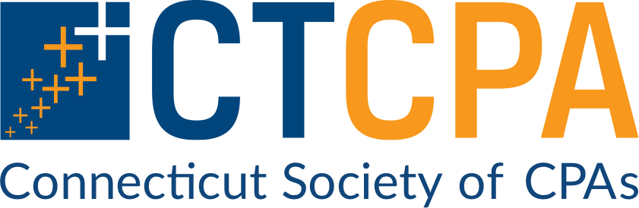
CTCPA TOWN HALL MEETING:
EMERGENCY PREPAREDNESS AND DISASTER RECOVERY

Slide 2
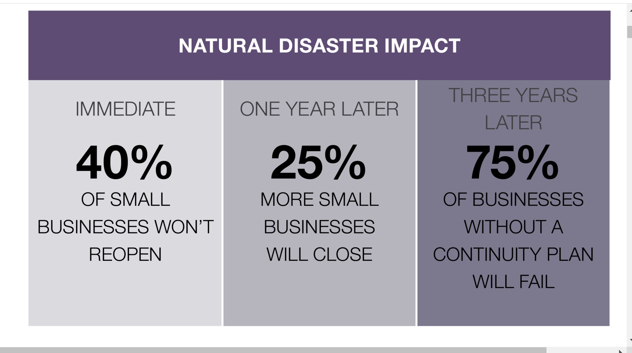

Slide 3
Business Resilience Guide: Reducing Risks and Building on Strengths
When disaster strikes, even the best run businesses can be impacted.
Between 25-40% of businesses do not reopen after disasters.
Some businesses cope with adversity better than others – they are less disrupted by an event, resume operations sooner, recover faster, and adjust for the future based on their experience. These businesses are described as resilient.
For a small business, resilience involves:
Understanding risks and planning for them,
Identifying employee needs and responsibilities,
Ensuring back-ups and redundancies are in place.
Thinking about how these risks would disrupt your operations and planning for them will enable you to rebound quicker and avoid a recurrence.

Slide 4

Start your Business Continuity Plan (BCP) by documenting how your business runs during “blue skies” and then identify possible courses of action.
Inventory and Equipment // Data and Computers
Many businesses have specialized equipment, supplies or technology that can play a critical part in making their business operations eﬀective. Without those key inputs a business may have to reduce its output of products or services. Identifying critical equipment and inventory that is necessary for your business’ essential functions will enable you to determine the steps that will allow you to reestablish operations quickly should a disaster occur.
BEFORE A STORM HITS – Move equipment to another location if necessary – and identify power supply options in case of electrical grid failure – common in most storms.
BCP Plans available at Ready.gov

Slide 5


Slide 6
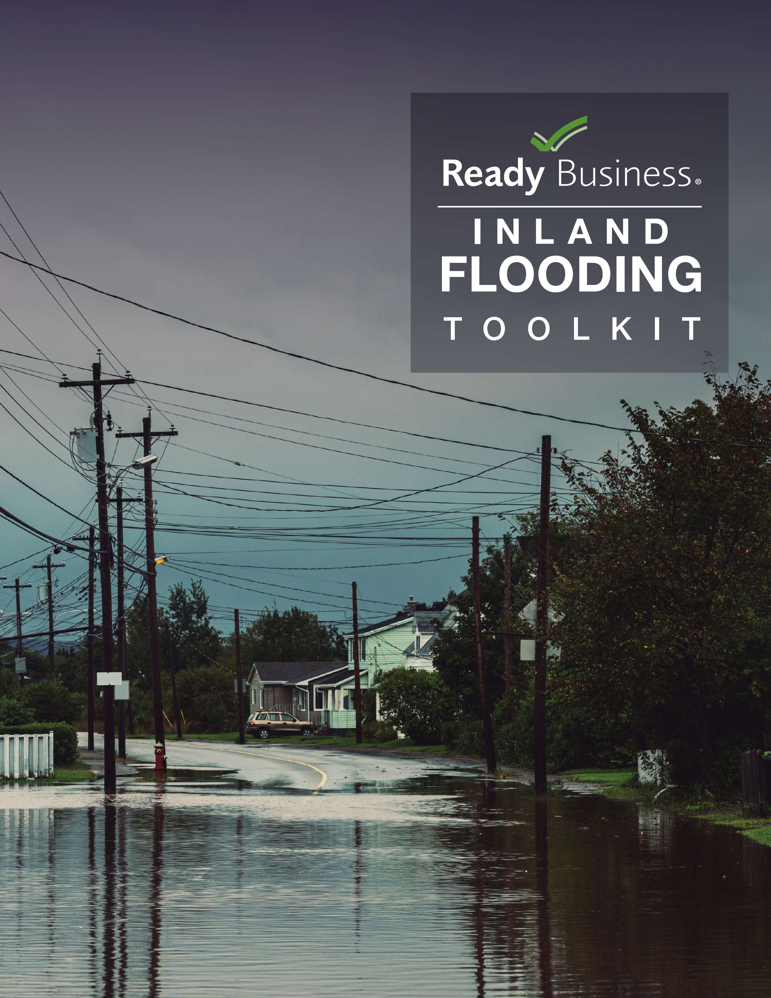
READY.GOV BUSINESS TOOL KIT

Slide 7
REVIEW YOUR OPERATIONS TO DETERMINE RECOVERY AND RESILIENCE OPTIONS TO GET YOUR BUSINESS UP AND RUNNING QUICKLY. Impacts to consider include the following:
Lost sales or delayed income
Increased expenses due to outsourcing, overtime, express shipping, etc.
Customer dissatisfaction
Contractual liabilities
Think about the consequences that would result if a particular business function could not be performed and determine whether there might be work-arounds to minimize disruption. Having redundancies in business functions can help you resume operations faster.
Eliminate single points of failure, like having only one supplier for a critical item. Generating options in advance of a disaster can make the resumption of your business functions easier when something happens.
Vulnerability Assessment
Depending on a range of factors, such as your location or type of business, you might face diﬀerent kinds of risk. Identifying these risks and prioritizing them can help you prepare eﬀectively and minimize the extent to which you are vulnerable. The frequency and intensity of those hazards that your area experienced in the past may be diﬀerent in the future.
For example, until 2023, tornadoes were rare in the Northeast -

Slide 8
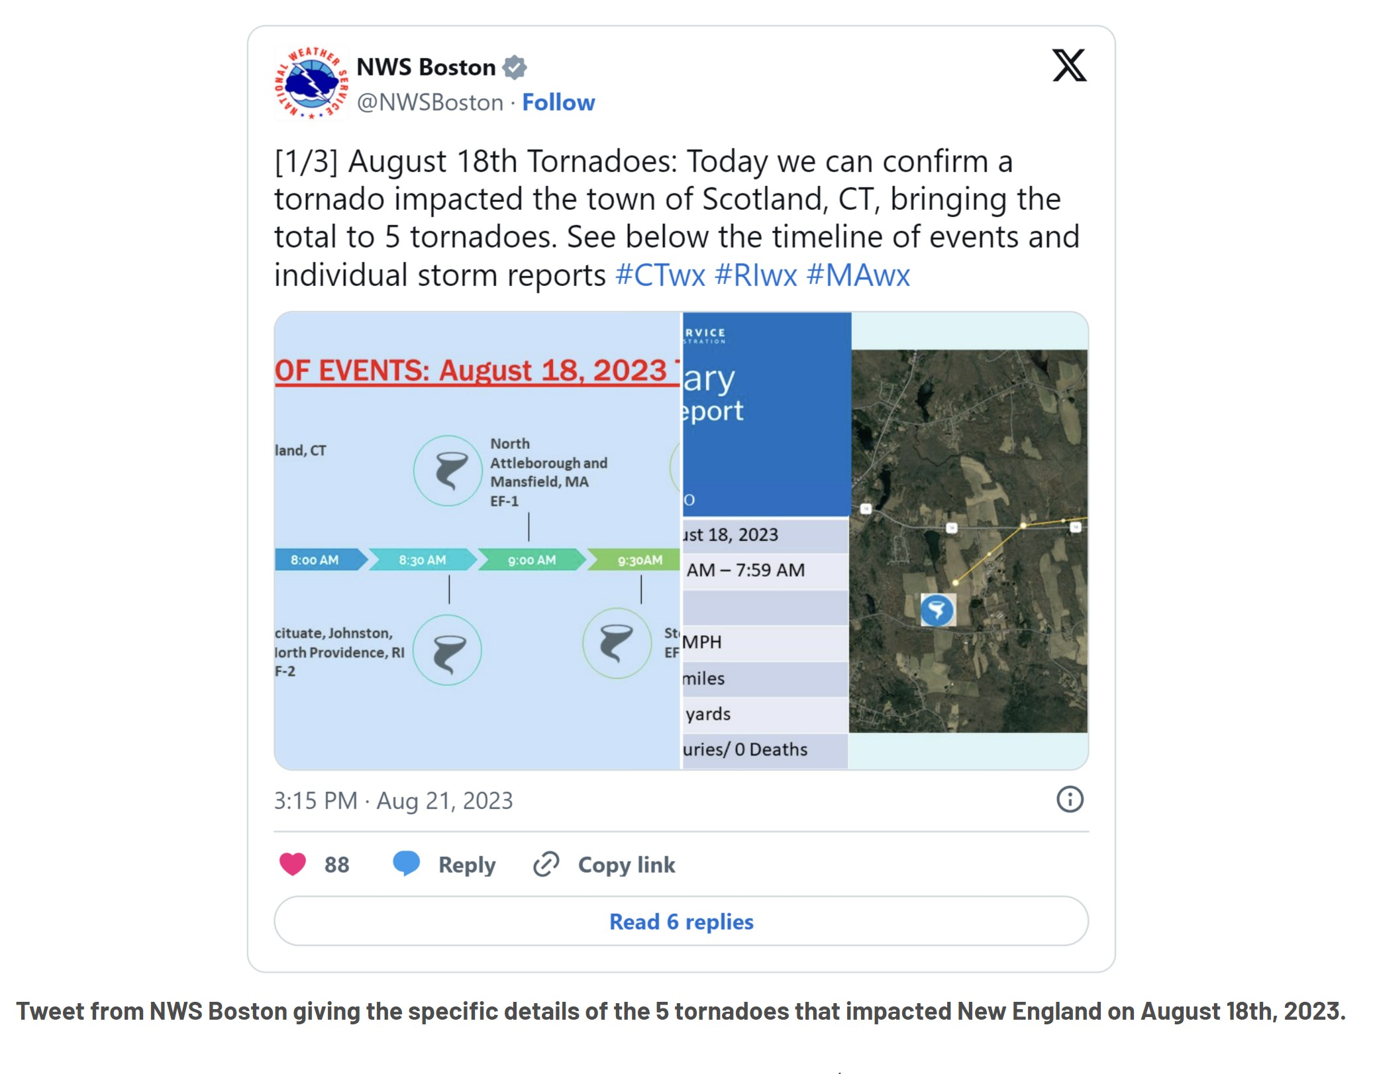

Slide 9
Entering your zip code into the National Oceanic and Atmospheric Administration tool¹ can help you project future climate conditions using mapping data. Aside from natural hazards, risks to consider include security and technology related risks, pandemics, and other types of disruptions.
Armed with historical data and future conditions projections, you can do a simple exercise to determine which threats you should focus on to reduce your vulnerabilities. Using the table below, list the threats that concern you (a few rows are populated with examples, but these may not be the main threats in your area). Then consider the likelihood of that threat happening on a scale of 1 to 5, and how damaging its impacts would be on a scale of 1 to 5. Multiply these two numbers, and the threats that get the highest total should be prioritized for planning purposes.
Example of threat calculation (likelihood X severity determines priority)
Threat | Likelihood (1-5) | Severity (1-5) | Total | Priority
Pandemic | 2 | 5 | 10 | #3
Flood | 4 | 3 | 12 | #2
Tornado | 3 | 5 | 15 | #1
¹ https://resilience.climate.gov/pages/learn-more

Slide 10
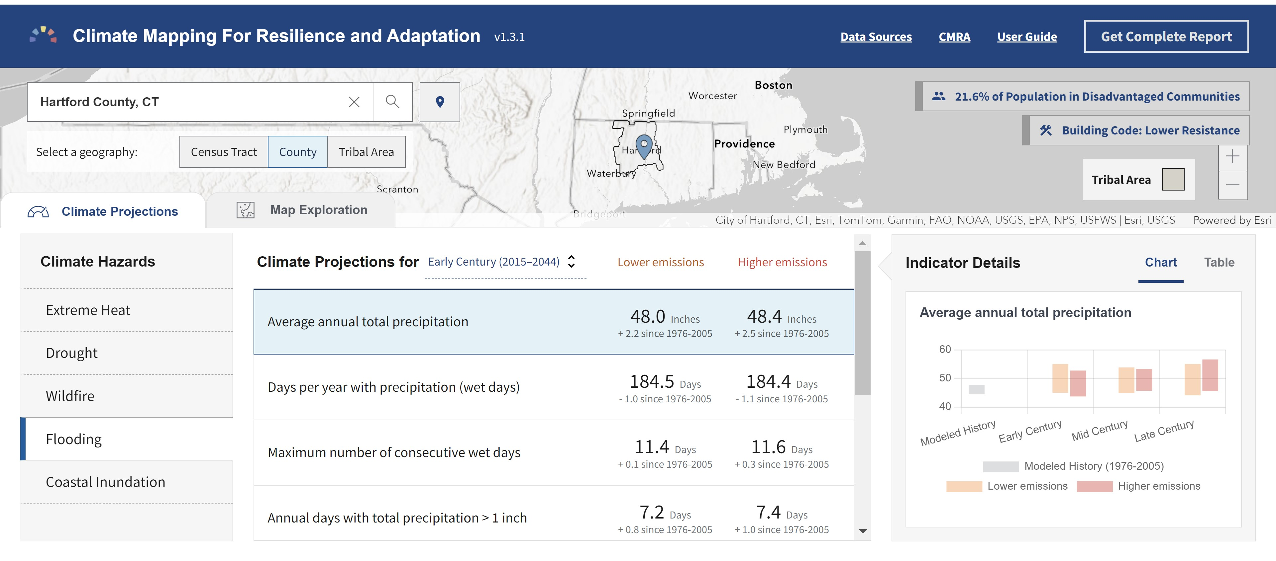

Slide 11

IMPORTANT STEPS A BUSINESS CAN TAKE:
Essential Contacts – Plan for internet/communication outage
Maintain up-to-date contact list of employees and other relevant
individuals such as your insurance agent, accountant, and attorney
Essential contacts should be maintained electronically and in print – save to USB and other devices to back-up data.
Confirm managers and HR team have current phone numbers and contact information for ALL employees.
STAGE AN EMERGENCY PLANNING DRILL WITH EMPLOYEES

Slide 12

PROTECT PEOPLE, DATA AND RESOURCES
Is your building, office or business park up to date with the latest building codes?
  Review your lease agreement: If you lease your workspace, decisions about reopening or changes to the building after a disaster may be made without your input - It could be beneficial to establish a rapport with the owner to have a say in these decisions.
  When looking at office or rental space, look at the property history and records
Employee Access:
  Determine in advance whether employees will be allowed to return to the office or facility – and when
  Identify employees who will be allowed to enter the location after the disaster.

Slide 13
INSURANCE – IS YOUR COVERAGE UP TO DATE?
Is your insurance policy current?
Many insurance policies do not automatically include coverage for flooding, earthquakes, or business interruption. Review your policy carefully for deductibles and gaps in coverage. Some insurance companies may offer premium reductions if you update your building to meet current structural or building codes.
Building coverage typically protects up to the insured value of the structure if it’s damaged or destroyed by wind, hail, or other covered events. However, you must own the building and it does not cover damage caused by floods, storm surges, or earth movement like landslides or earthquakes unless those risks are added by endorsement.
Business personal property insurance covers the contents and inventory of your business if they are damaged or destroyed by wind, hail, or other covered events.
Consider coverage for improvements or additions to a building you occupy but do not own for office supplies, internal fixtures, alterations, or installations you’ve made at your own expense.
Business income insurance covers lost revenue and normal operating expenses if your business becomes uninhabitable due to a covered loss, providing support while repairs are underway.

Slide 14
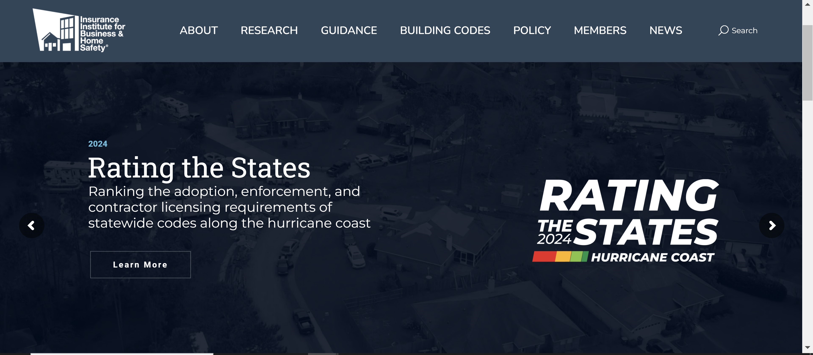

Slide 15
MITIGATING FLOODING EVENTS
Flooding may include inundation from riverine flooding, coastal flooding, or storm surge. Flooding may result from hurricanes, severe thunderstorms, or be due to snow and ice melt.
Low-Cost
Installing sump pumps: Installing sump pumps can remove excess water from basements or crawl spaces, reducing the risk of flooding and water damage.
High-Cost
Elevating structures: Elevating structures above flood levels can prevent significant flood damage.
Flood gates or doors: Installing adjustable barriers can divert the flow of water.
PERFORM INVENTORY AND EQUIPMENT ASSESSMENTS
Ready.gov
US Small Business Administration sba.gov

Slide 16
Appendix A: Inventory and Equipment
Use this form to document key equipment, machinery, supplies, and other items you will need to fulfill your critical business functions. Attach photos as appropriate.
Item:
Related business function: Brief description of item: Location within the facility: Manufacturer: Model number: Serial number: Asset tag number: Quantity: Purchase/lease date: Acquired new or used:
Price paid: Warranty or service contract information: If the equipment is replaceable, indicate how long it would take to replace: Is vendor installation required?
If the equipment can be fixed, indicate how long it would take to become functional?
Are spare parts available? Are spare parts on hand in your facility? Primary supplier:
Alternate supplier: If the equipment cannot be easily replaced, indicate potential workarounds:
Notes:

Slide 17
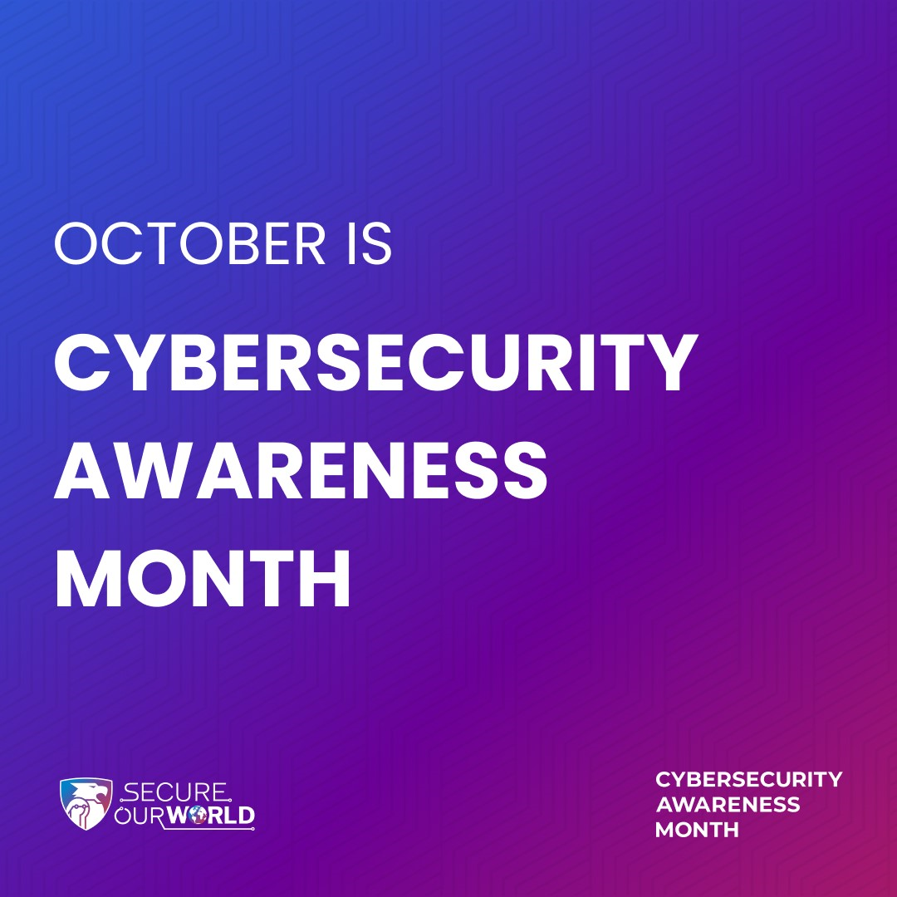


Slide 18
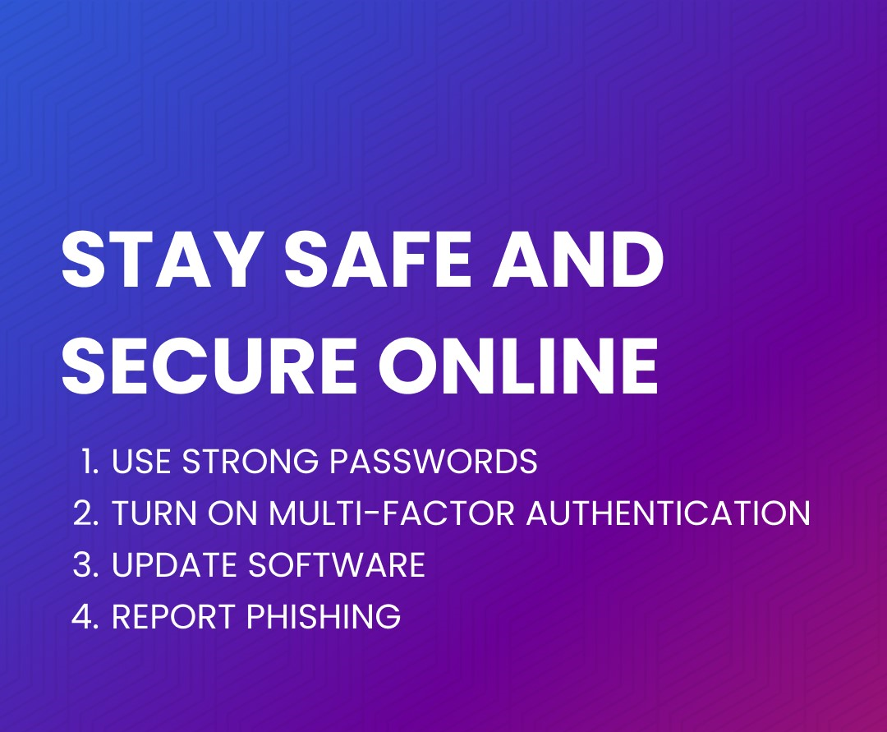

Slide 19
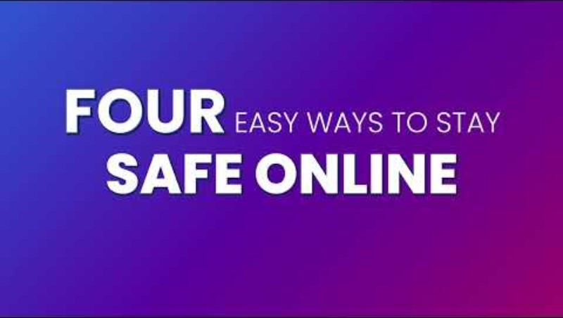
“Four Easy Ways to Stay Safe Online”

